Slide 1
Physical Layer
Lecture 8-9 (Theory)
Dr. Yogesh
Department of Computer Science and Engineering,
Chitkara University, Punjab
Computer Networks _22CS008

Slide 2
INDEX
Transmission Media (Cable Media)
Wireless Media (Cellular Phones, Satellite Networks)
Types of Connecting Devices (Hub, Switch, Routers)

Slide 3
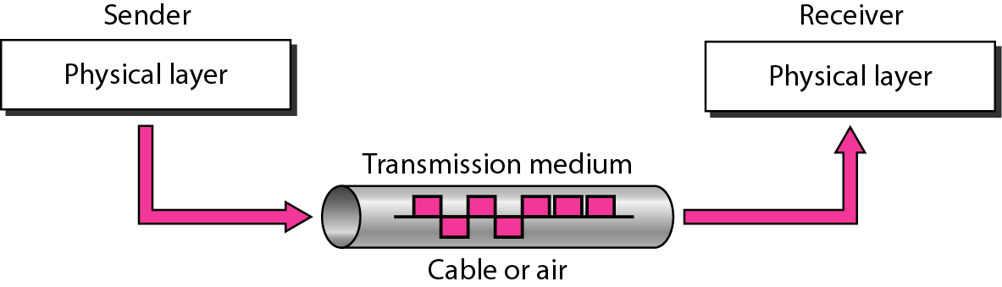
TRANSMISSION MEDIUM AND PHYSICAL LAYER
Transmission media is a communication channel that carries the information from the sender to the receiver.
Data is transmitted through the electromagnetic signals.
The main functionality of the transmission media is to carry the information in the form of bits through LAN(Local Area Network).
Fig. 1 Transmission medium and Physical layer

Slide 4
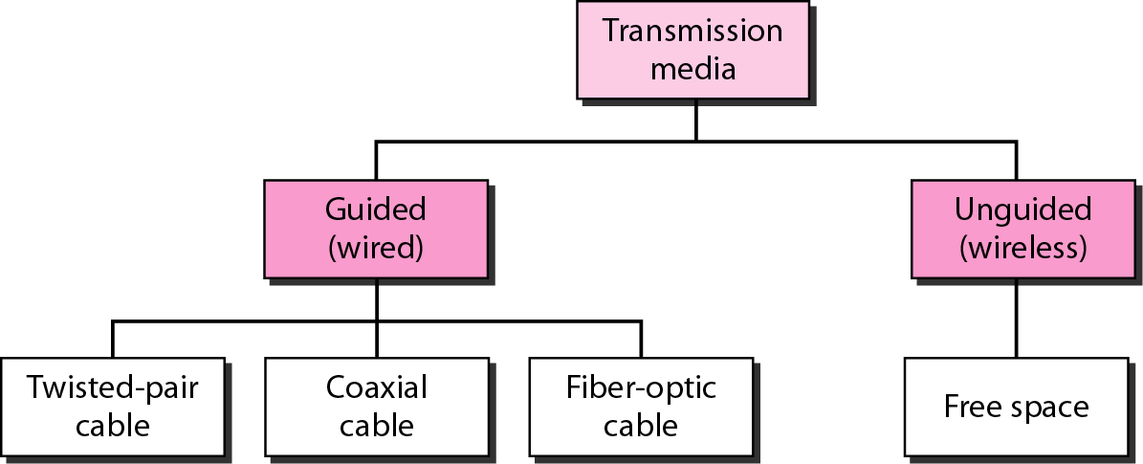
CLASSES OF TRANSMISSION MEDIA
Fig. 2 Classes of transmission media

Slide 5
GUIDED MEDIA
It is also referred as Wired or Bounded transmission media. Signals being transmitted are directed and confined in a narrow pathway by using physical links.
Features:
High Speed
Secure
Used for comparatively shorter distances.
There are 3 major types of Guided Media:
Twisted Pair Cable.
Coaxial Cable.
Optical Fiber Cable

Slide 6
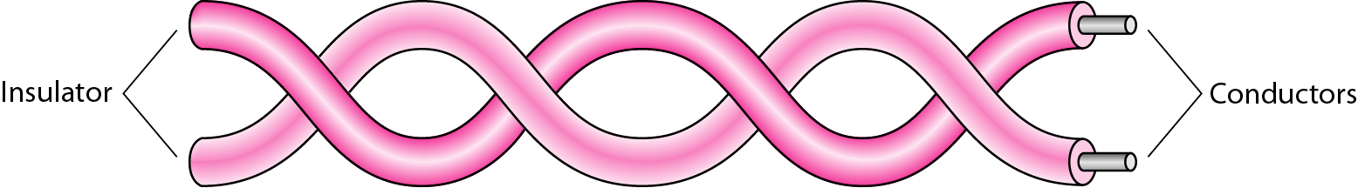
TWISTED PAIR CABLE
It consists of 2 separately insulated conductor wires wound about each other.
Generally, several such pairs are bundled together in a protective sheath.
They are the most widely used Transmission Media.
Fig. 3 Twisted pair cable

Slide 7
APPLICATION OF TWISTED PAIR
Application of Twisted Pair:
Telephone network
Between house and local exchange (subscriber loop)
Within buildings
To private branch exchange (PBX)
For local area networks (LAN)
10Mbps or 100Mbps
Twisted Pair is of two types:
Unshielded Twisted Pair (UTP)
Shielded Twisted Pair(STP)

Slide 8
UNSHIELDED TWISTED PAIR (UTP) AND SHIELDED TWISTED PAIR(STP)
Unshielded Twisted Pair (UTP)
UTP consists of two insulated copper wires twisted around one another.
This type of cable can block interference and does not depend on a physical shield for this purpose.
It is used for telephonic applications.
Advantages:
Least expensive
Easy to install
High-speed capacity
Susceptible to external interference
Lower capacity and performance in comparison to STP
Short distance transmission due to attenuation

Slide 9
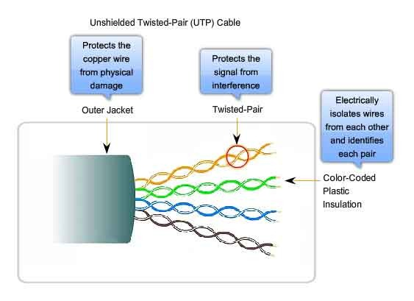
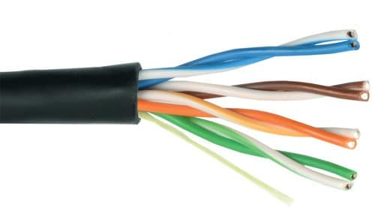
UNSHIELDED TWISTED PAIR (UTP)
Fig.4 Unshielded twisted pair

Slide 10
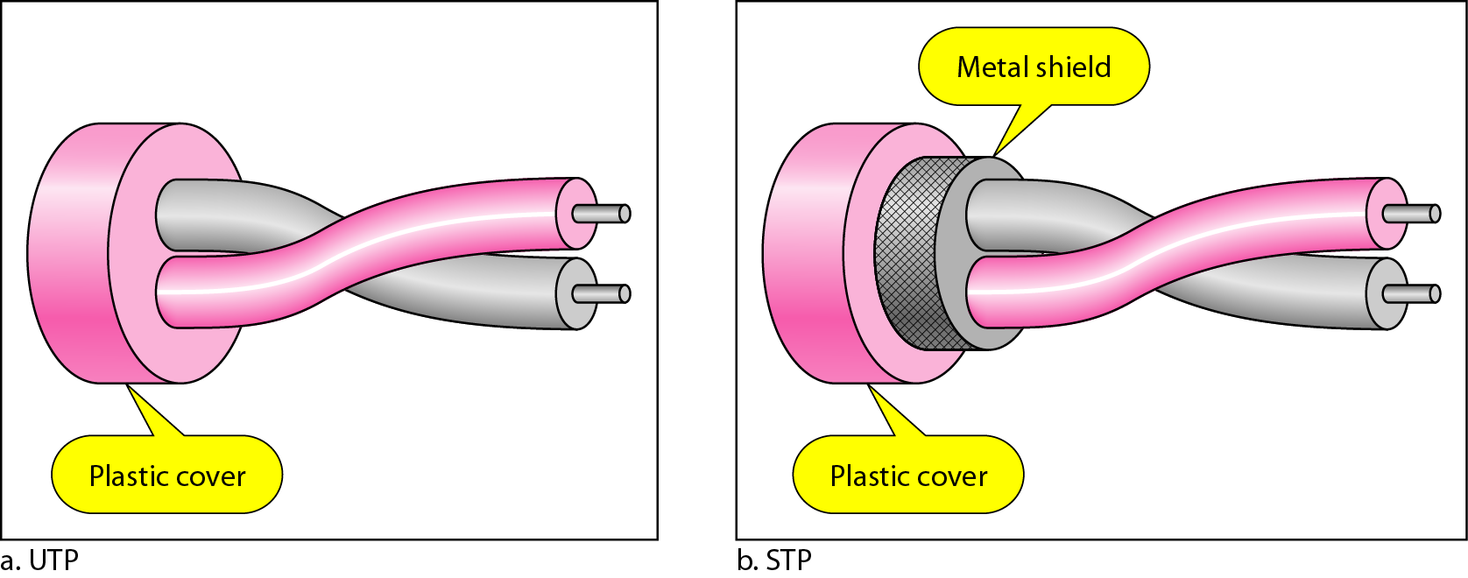
SHIELDED TWISTED PAIR(STP)
Shielded Twisted Pair (STP):
This type of cable consists of a special jacket (a copper braid covering or a foil shield) to block external interference.
It is used in fast-data-rate Ethernet and in voice and data channels of telephone lines.
Fig. 5 Shielded twisted pair

Slide 11
SHIELDED TWISTED PAIR(STP)
Advantages:
Better performance at a higher data rate in comparison to UTP
Eliminates crosstalk
Comparatively faster
Comparatively difficult to install and manufacture
More expensive
Bulky

Slide 12
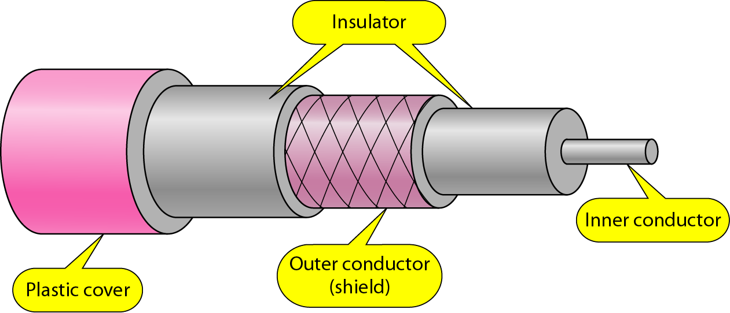
COAXIAL CABLE
It has an outer plastic covering containing an insulation layer made of PVC or Teflon and 2 parallel conductors each having a separate insulated protection cover.
The coaxial cable transmits information in two modes: Baseband mode(dedicated cable bandwidth) and Broadband mode(cable bandwidth is split into separate ranges).
Cable TVs and analog television networks widely use Coaxial cables.
Fig. 6 Coaxial cable

Slide 13
ADVANTAGES AND DISADVANTAGES OF COAXIAL CABLES
Advantages:
High Bandwidth
Better noise Immunity
Easy to install and expand
Inexpensive
Disadvantages:
Single cable failure can disrupt the entire network.

Slide 14
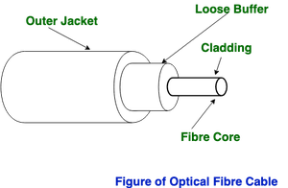
OPTICAL FIBER CABLE
It uses the concept of reflection of light through a core made up of glass or plastic.
The core is surrounded by a less dense glass or plastic covering called the cladding.
It is used for the transmission of large volumes of data.
The cable can be unidirectional or bidirectional.
The WDM (Wavelength Division Multiplexer) supports two modes, namely unidirectional and bidirectional mode.
Fig. 7 Optical fiber cable

Slide 15
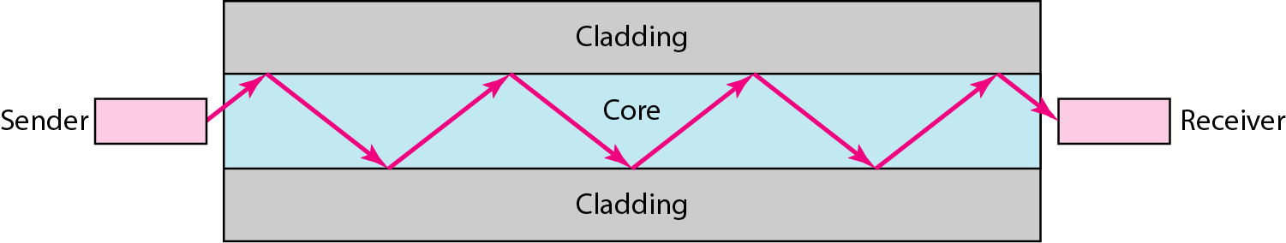
OPTICAL FIBER CABLE
Fig. 8 Optical fiber cable
Advantages:
Greater capacity
Data rates of hundreds of Gbps
Smaller size & weight
Lower attenuation
Electromagnetic isolation
Greater repeater spacing
10s of km at least

Slide 16
OPTICAL FIBER CABLE
Applications:
Long-haul trunks
Metropolitan trunks
Rural exchange trunks
Subscriber loops
LANs

Slide 17
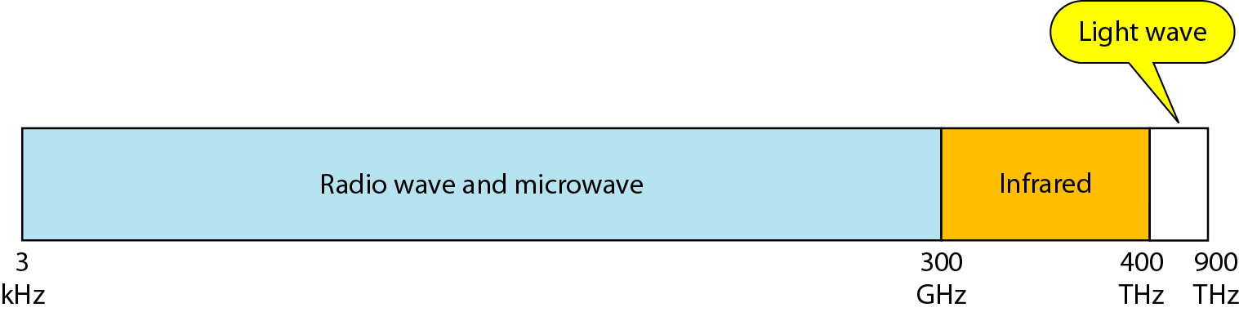
UNGUIDED MEDIA
It is also referred to as Wireless or Unbounded transmission media.
No physical medium is required for the transmission of electromagnetic signals.
Features of Unguided Media:
The signal is broadcasted through air
Less Secure
Used for larger distances
Electromagnetic spectrum of Unguided media shown below:
Fig. 9 Unguided media

Slide 18
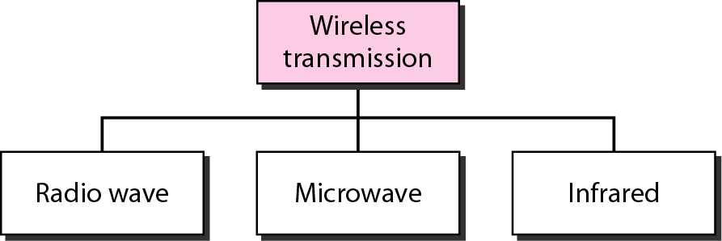
UNGUIDED MEDIA
There are 3 types of Signals transmitted through unguided media:
(i) Radio waves
(ii) Microwaves
(iii) Infrared
Fig. 10 Unguided media

Slide 19
INFRARED
Infrared is used for short-range communication like TV remotes, mobile phones, personal computers etc.
In science, the Infrared is part of a spectrum that is not visible to the human eye.
The limitation of infrared rays is that they cannot penetrate any obstacles and can only use for short-range.
Also, Infrared is used in night vision cameras as it has thermal properties. The frequency range of infrared rays 300GHz – 400THz.
Advantage and Disadvantage:
Infrared is one of the secure wireless communication mediums as it is used for short-range. Also, unlike other wireless mediums, infrared is quite inexpensive, and this is some reason it is used in many electronic devices.
Disadvantage part of Infrared waves is that they can only be used in short-range communication. Also, they cannot penetrate any obstacles like walls or any building.

Slide 20
INFRARED
INFRARED SIGNALS CAN BE USED FOR SHORT-RANGE COMMUNICATION IN A CLOSED AREA USING LINE-OF-SIGHT PROPAGATION.

Slide 21
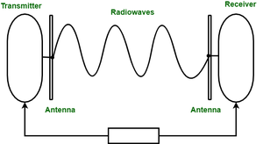
RADIO WAVES
To overcome the limitation of Infrared ,we are using Radio waves.
They can travel large distances as well as can penetrate through buildings.
The requirement of radio waves is antennas, sending antennas where one can transmit its message and the other is receiving antennas.
Frequency Range:3KHz – 1GHz.
AM and FM radios and cordless phones use Radio waves for transmission.
Fig. 11 Radio waves

Slide 22
RADIO WAVES
Advantage and Disadvantage:
Radio waves have some advantages like they can travel long distances in all directions and can pass through any obstacles,
Since they are wireless communication mediums so there is no need of digging and spreading wires.
Radio waves have some disadvantages too like radio waves are not effective in bad weather conditions, and they are less secure as they can travel large distances.
RADIO WAVES ARE USED FOR MULTICAST COMMUNICATIONS, SUCH AS RADIO AND TELEVISION, AND PAGING SYSTEMS.

Slide 23
MICROWAVES
Microwaves are a line of sight transmission, meaning both the antennas sending and receiving should be properly aligned. Also, the distance covered by the signal is directly proportional to the height of the antenna.
Microwaves have a frequency Range between 1GHz – 300GHz. Basically, we used Microwaves in mobile phones communication and television distribution.
Unlike radio waves, they are unidirectional, as they can move in only one direction, and therefore it is used in point-to-point communication or unicast communication such as radar and satellite.
Microwaves are used in mobile phones communication and television distribution.
Microwaves are used for unicast communication such as cellular telephones, satellite networks, and wireless LANs.

Slide 24
MICROWAVES
Advantage and Disadvantage:
Microwaves have advantages that it is a very fast way of communication, that can carry 25000 voice channels at the same time.
Also, it is a wireless communication medium so there is no need of digging and spreading wires.
Microwave have disadvantages that of their installation and maintenance are very expensive. that turns this into a very expensive mode of communication.
Moreover, Microwaves are also not very effective in bad weather conditions.

Slide 25
COMPARISON OF INFRARED, RADIO WAVES, MICROWAVES
Infrared | Radio Waves | Microwaves
Infrared is used for short-range communication like TV remotes, mobile phones, personal computers, etc. | Radio waves are the type of wireless communication that can travel large distances as well as can penetrate any wall | Microwaves are a line of sight transmission, meaning both the antennas sending and receiving should be properly aligned.
The frequency range of infrared rays 300GHz – 400THz | The frequency range of radio waves: 3KHz – 1GHz. | Microwaves have a frequency Range between 1GHz – 300GHz.
The limitation of infrared rays is that they cannot penetrate any obstacles and can only use for short-range. | It can travel large distances as well as can penetrate any wall. | They are unidirectional, as they can move in only one direction, such as radar and satellite.
Infrared waves are used in TV remotes, mobile phones, personal computers | Radio waves are used in AM and FM radios, and cordless phones. | Microwaves are used in mobile phones communication and television distribution.

Slide 26
ETHERNET
Ethernet (pronounced “eether net”) is a most widely used LAN technology , which is defined under IEEE standards 802.3.
Ethernet network is used to create local area network and connect multiple computers or other devices such as printers, scanners, and so on.
In a wired network, this is done with the help of fiber optic cables, while in a wireless network, it is done through wireless network technology.
An Ethernet network uses various topologies such as star, bus, ring, and more.
Ethernet connecting computers together with cable so the computers can share information.
Ethernet operates in the data link layer and the physical layer.

Slide 27
ETHERNET
Wired Ethernet:
Wired Ethernet network, devices are connected with the help of a fiber optic cable which connects the devices within a distance of 10km.
For this, we have to install a computer network interface card (NIC) in each computer. A unique address is given to each computer that is connected.
Ethernet is a shared medium network technology, where all the workstations are connected to the same cable and must connect with one another to send signals over it.
Wireless Ethernet
In this, wireless NICs are used for connecting the computer instead of a cable.
These wireless NICs make use of radio waves for communicating between the systems and furthers these NICs are connected with a wireless switch or hub.

Slide 28
ETHERNET
Ethernet network can be classified into Four types:
i) Standard Ethernet
ii) Fast Ethernet
iii) Gigabit Ethernet
iv) Ten-Gigabit Ethernet
i) Standard Ethernet:
This type of Ethernet can transfer data at a rate of 10 Mbps.
ii) Fast Ethernet:
This type of Ethernet can transfer data at a rate of 100 Mbps.
Fast Ethernet makes use of twisted pair cable or fiber optic cable for communication.

Slide 29
ETHERNET
iii) Gigabyte Ethernet:
This type of Ethernet network can transfer data at a rate of 1000 Mbps.
Gigabit Ethernet also makes use of twisted pair cable or fiber optic cable. 48 bits used for addressing in Gigabit Ethernet.
The latest Gigabit Ethernet is a 10 Gigabit Ethernet, which can transfer data at a rate of 10 Gbps.
Gigabit Ethernet was developed so that it can meet the needs of the user like faster communication network, faster transfer of data etc.
iv) Ten-Gigabit Ethernet:
10 Gigabit Ethernet is the recent generation and delivers a data rate of 10 Gbit/s (10,000 Mbit/s).
It is generally used for backbones in high-end applications requiring high data rates.

Slide 30
ETHERNET
Various Types of Ethernet Cables:
10Base2: This is a thin twisted pair coaxial cable.
10Base5: This is thick twisted pair coaxial cables.
10Base T: This is a twisted pair cable which offers a speed of around 10 Mbps.
100BaseTX: This is a twisted pair cable and offer a speed of 100 Mbps.
100Base FX: Fiber optic protocol which offers a speed of 100 Mbps.
1000Base SX: Fiber optic protocol which utilizes a wavelength of 850nm for multimode networks.
1000Base LX: Fiber optic protocol which utilizes a wavelength of 1310 nm, for multimode networks and up to 1550nm for single mode networks.

Slide 31
CONNECTING DEVICES
Repeaters
Hubs
Switches
Bridges
Router
Gateways
Network Interface Cards (NICs)
Wireless access points
Modems

Slide 32
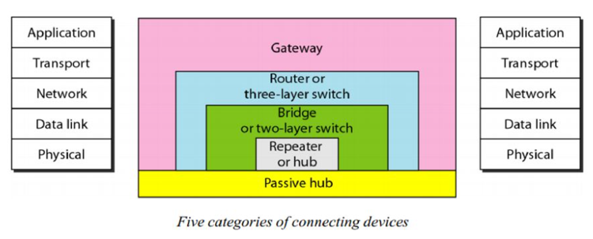
CONNECTING DEVICES
Connecting devices are divided into 5 different categories based on the layer in which they operate in the network.
Fig. 12 Connecting devices

Slide 33
HUB
A hub is used as a central point of connection among media segments.
A Hub is a hardware device used to connect several computers together.
A hub contains multiple ports. Cables from network devices plug in to the ports on the hub.
Types of HUBS :–
A passive hub is just a connector. It connects the wires coming from different branches.
The signal pass through a passive hub without regeneration or amplification.
Connect several networking cables together
Active hubs or Multiport repeaters- They regenerate or amplify the signal before they are retransmitted.

Slide 34
HUB
Hubs Acts on the physical layer Operate on bits rather than frames also called multiport repeater
Used to connect stations adapters in a physical star topology but logically bus Connection to the hub consists of two pairs of twisted pair wire one for transmission and the other for receiving.
Hub receives a bit from an adapter and sends it to all the other adapters without implementing any access method. does not do filtering (forward a frame into a specific destination or drop it) just it copy the received frame onto all other links.

Slide 35
HUB
The entire hub forms a single collision domain, and a single Broadcast domain
Collision domain: is that part of the network (set of NICs) when two or more nodes transmit at the same time collision will happen.
Broadcast domain: is that part of the network (set of NIC) where each NIC can 'see' other NICs' traffic broadcast messages.
Multiple Hubs can be used to extend the network length
For 10BaseT and 100BaseT the maximum length of the connection between an adapter and the hub is 100 meters.

Slide 36
HUB
Hub Advantages:
simple, inexpensive device
Multi-tier provides graceful degradation
Portions of the LAN continue to operate if one hub malfunctions
As an active hubs regenerate signals, it increases the distance that can be spanned by the LAN (up to 100 meters per segment).
Hubs can also be connected locally to a maximum of two other hubs, thereby increasing the number of devices that can be attached to the LAN.
Active hubs are usually used against attenuation, which is a decrease in the strength of the signal over distance.

Slide 37
HUB
Hub Disadvantages:
Bandwidth is shared by all hosts i.e. 10Mbs shared by 25 ports/users.
Can create bottlenecks when used with switches.
Have no layer 3 switching capability.
Most Hubs are unable to utilize VLANS
Individual segment collision domains become one large collision domain (reduce the performance) can’t interconnect different Ethernet technologies (like 10BaseT & 100BaseT) because no buffering at the hub

Slide 38
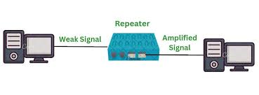
REPEATER
A physical layer device the acts on bits not on frames or packets
Can have two or more interfaces
When a bit (0,1) arrives, the repeater receives it and regenerates it, the transmits it onto all other interfaces.
Reference: https://www.geeksforgeeks.org/repeaters-in-computer-network/
Fig. (a) Repeater

Slide 39
REPEATER
Used in LAN to connect cable segments and extend the maximum cable length-extending the geographical LAN range
Ethernet 10base5 – Max. segment length 500m – 4 repeaters (5 segments) are used to extend the cable to 2500m)
Ethernet 10Base2- Max. segment length 185m - 4 repeaters (5 segments) are used to extend the cable to 925m
Repeaters do not implement any access method
If any two nodes on any two connected segments transmit at the same time collision will happen.

Slide 40
BRIDGE
Acts on Data Link Layer (MAC Address Level).
Used to divide segment LAN into smaller LANs segment or to connect LANs that use identical physical and DLL.
Each LAN segment is separate collision domain.
Bridge doesn't send the received frames to all other interfaces like hub, and repeaters but it performs filtering which means:
Whether the frame should be forwarded to another interface that leads to destination or dropped.

Slide 41
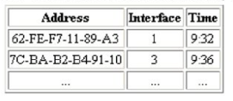
BRIDGE
This is done by the bridge table (forwarding table) that contains entries for the node on the LAN.
The bridge table is initially empty and filled automatically by learning from frames movement in the network.
An entry in the bridge table consists of : Node LAN (MAC) address, bridge interface to which node is connected to, the record creation time.
A bridge run CSMA/CD before sending the frame onto the link not like hub and repeater.
Bridge framing handling is done in a software.
Table 1 Bridge table

Slide 42
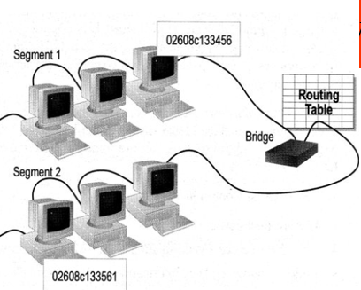
HOW BRIDGE WORKS
Bridges work at MAC sublayer of the OSI model.
Routing table is built to record the segmentation number of address.
If destination address is in the same segment as the source address, stop transmitting.
Otherwise forward to the other segment.
Fig. 13 Bridge working

Slide 43
TYPE OF BRIDGES
Transparent Bridge
Also called Learning bridge.
Build a table of MAC address as frame arrives.
Ethernet network use transparent bridge.
Duties of transparent bridge are: Filtering frames, forwarding and blocking
Source Routing Bridge
Used in Token Ring Networks.
Each station should determine the route to destination when it wants to send a frame and therefore include the route information in the header of frame.
Addresses of these bridges are included in the frame.
Frame contains not only the source and destination address but also the bridge address.

Slide 44
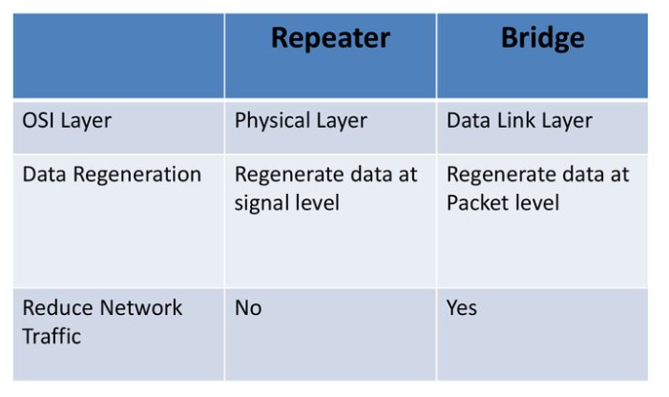
DIFFERENCE BETWEEN BRIDGE VS REPEATER
Table 2 Difference between bridge and repeater

Slide 45
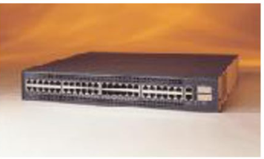
SWITCHES
Switches operate at the DLL (Layer 2) of the OSI Model.
Can interpret address information.
Switch resembles bridges and can be considered as multiport bridges.
By having multiport can better use limited bandwidth and prove more cost- effective than bridge.
Fig. 14 Switch

Slide 46
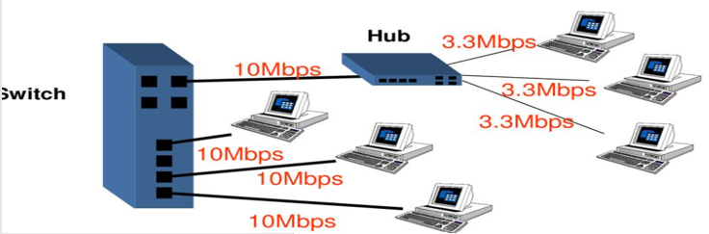
SWITCHES
Switches divide the network into several isolated channels.
Packets sending from one channel will not go to another if not specified.
Each channel has its own capacity and need not to be shared with other channel.
Forward only to the ports that connects to the destination device.
Knows MAC address
Match the MAC address in the data they received.
Fig. 15 Switch

Slide 47
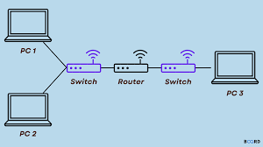
ROUTER
Routers Operates at network layer = deals with packets not frames Connect LANs and WANs with similar or different protocols together
Switches and bridges isolate collision domains but forward broadcast messages to all LANs connected to them.
Fig. (b) Router
Reference: https://www.boardinfinity.com/blog/routing-table-in-computer-networks/

Slide 48
ROUTER
Routers isolate both collision domains and broadcast domains
Acts like normal stations on a network, but have more than one network address (an address to each connected network)Deals with global address ( network layer address (IP)) not local address (MAC address)Routers Communicate with each other and exchange routing information
Determine best route using routing algorithm by special software installed on them
Forward traffic if information on destination is available otherwise discard it (not like a switch or bridge)

Slide 49
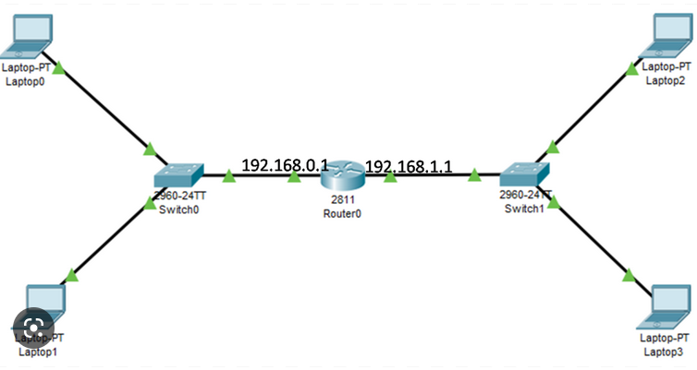
GATEWAY
A gateway is a network node used in telecommunications that connects two networks with different transmission protocols together.
Gateways serve as an entry and exit point for a network as all data must pass through or communicate with the gateway prior to being routed.
In most IP-based networks, the only traffic that does not go through at least one gateway is traffic flowing among nodes on the same local area network (LAN) segment.
Fig. 16 Gateway

Slide 50
NETWORK INTERFACE CARD (NIC)
A network interface card (NIC) is a hardware component without which a computer cannot be connected over a network. It is a circuit board installed in a computer that provides a dedicated network connection to the computer. It is also called network interface controller, network adapter or LAN adapter.
Purpose
NIC allows both wired and wireless communications.
NIC allows communications between computers connected via local area network (LAN) as well as communications over large-scale network through Internet Protocol (IP).
NIC is both a physical layer and a data link layer device, i.e. it provides the necessary hardware circuitry so that the physical layer processes and some data link layer processes can run on it.

Slide 51
WIRELESS ACCESS POINT & MODEM
An access point is a device that creates a wireless local area network, or WLAN, usually in an office or large building. An access point connects to a wired router, switch, or hub via an Ethernet cable, and projects a Wi-Fi signal to a designated area.
MODEM
A modem is a network device that both modulates and demodulates analog carrier signals (called sine waves) for encoding and decoding digital information for processing. Modems accomplish both of these tasks simultaneously and, for this reason, the term modem is a combination of "modulate" and "demodulate."

Slide 52
WIRELESS ACCESS POINT & MODEM
Features of Modems
The main features of modems are as follows −
They have high uploading and communication rates. An X2 modem provides an uploading bandwidth between 28.8 to 56 Kbps.
They are upgradeable through a software patch to meet almost any universal standard.
They enable high-speed downstream data transfers by digitally encoding all downstream data while upstream runs at conventional rates of 33.6 kbps.
Some modems incorporate dual simultaneous voice and Data (DSVD), i.e., they can carry both analog voices and computer data.
They can detect callers originating telephone number, and thus they can serve as caller ID.
Some modems provide advanced voice mail features, and those modems serve as intelligent, answering machines or digital information systems.

Slide 53
Q & A
Which of the following is a type of cable media used in computer networks?
Coaxial cable
(b) Fiber optic cable
(c) Both (a) and (b)
(d) None of the above
Answer: (c) Both (a) and (b)
What is the main advantage of fiber optic cable compared to coaxial cable?
Lower cost
Higher bandwidth
More susceptible to interference
Easier to install
Answer: (b) Higher bandwidth

Slide 54
Q & A
Bluetooth is an example of which type of wireless media?
Cellular network
Satellite network
Short-range wireless
Long-range wireless
Answer: (c) Short-range wireless
A hub in a network operates at which layer of the OSI model?
Physical layer
Data Link layer
Network layer
Transport layer
Answer: (a) Physical layer

Slide 55
Q & A
Switches differ from hubs by:
Providing higher bandwidth
Forwarding data only to the intended recipient
Both (a) and (b)
Neither (a) nor (b)
Answer: (b) Forwarding data only to the intended recipient
The primary function of a router is to:
Connect devices within a network
Connect different networks together
Amplify network signals
Secure data transmission
Answer: (b) Connect different networks together

Slide 56
References
https://www.netacad.com/portal/resources/browse/c23f30cd-217f-40d7-bc7b-218d5307f22b
https://www.ciscopress.com/articles/article.asp?p=169686

